Slide 1
Term methodology
Data Cleaning in R

Slide 2
Steps
Importing data
Merging data
Validating data
Cleaning data

Slide 3
Overview
TERM data is shared monthly by Radarr. With a new hybrid QA approach (immediate cleansing and analysis once data is received using both automated code and human review) we can improve the turnaround and confidence in our reporting efforts.

Slide 4
Importing data
read_excel()

Slide 5
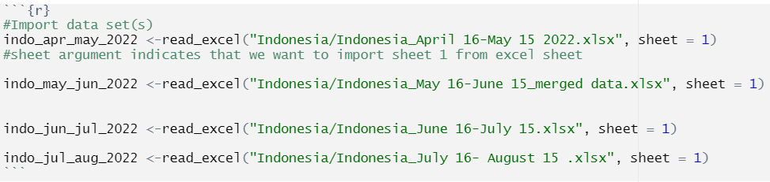
Code
Individually import monthly data
* We should keep naming conventions consistent for all data

Slide 6
merging data
full_join()

Slide 7
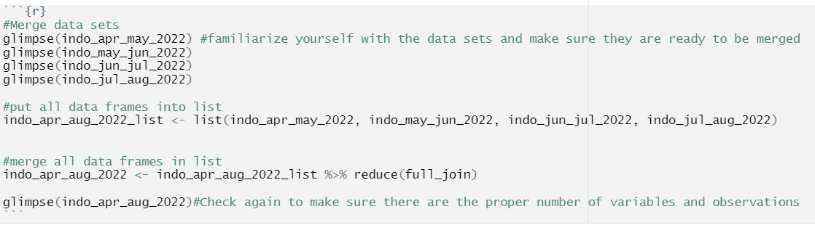
Code
Examine individual dataset structure
All columns that you want to merge on, must have the same name and data type

Slide 8
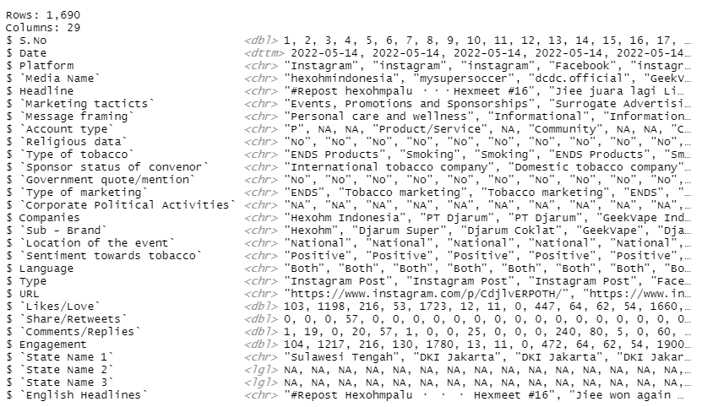
Output

Slide 9
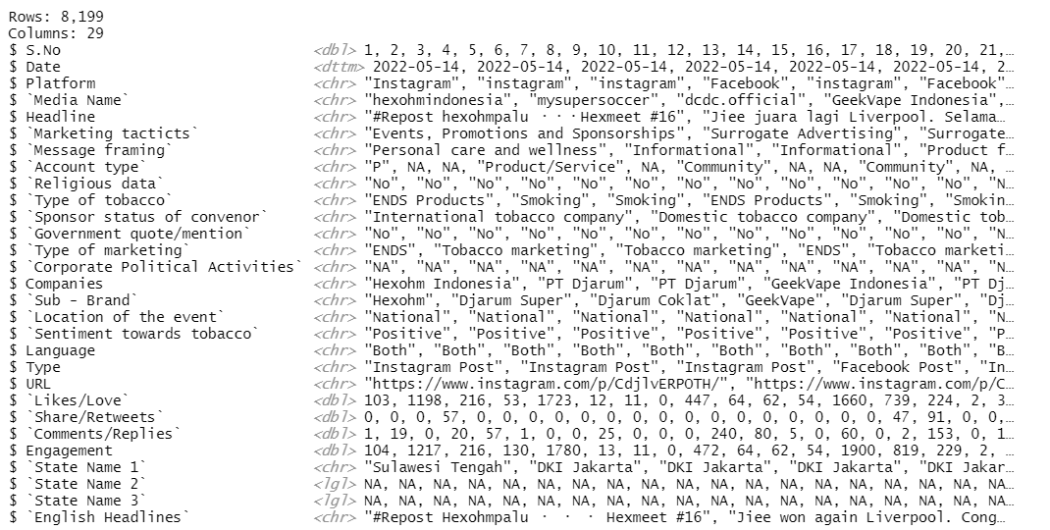
Output

Slide 10
validating data ex. 1
set_diff()

Slide 11
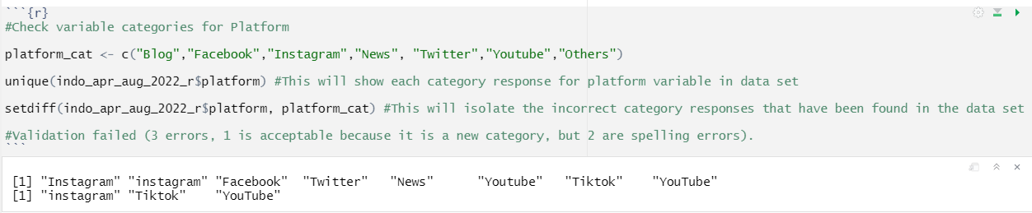
Code
Create list of all valid response options from codebook
Compare list of valid response options to response options detected in dataset
Isolate invalid response options

Slide 12
cleaning data ex. 1
mapvalues()

Slide 13
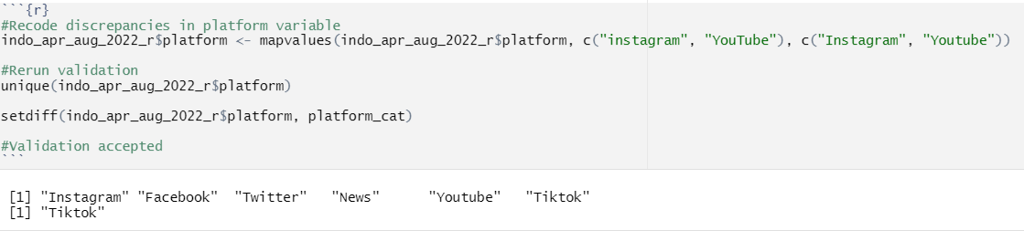
Code
Recode invalid response options that cannot be accepted
Rerun validation test

Slide 14
validating data ex. 2
set_diff()

Slide 15
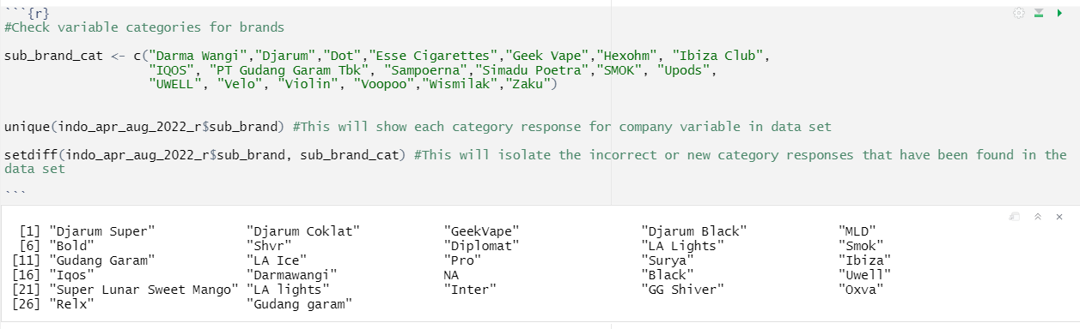
Code
Create list of all valid response options from codebook
Compare list of valid response options to response options detected in dataset
Isolate invalid response options

Slide 16
cleaning data ex. 2
mutate() , casewhen()

Slide 17
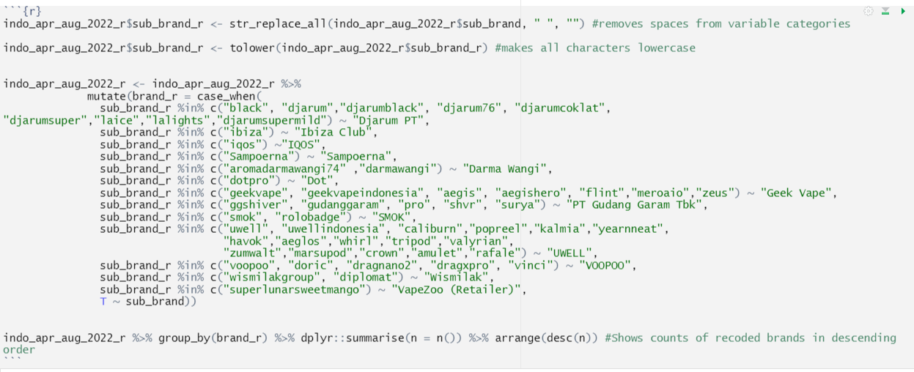
Code
Create individual lists for each brand containing all possible model types
Search for any product that has been coded as a model
If model mention is found, recode product to correct response option

Slide 18
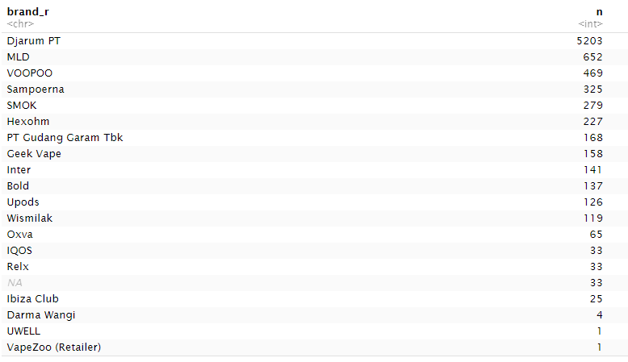
Output
Manually check frequency counts
“Unknown” responses with high frequencies could indicate some form of surrogate marketing

Slide 19
validating data ex. 3
get_dupes()

Slide 20
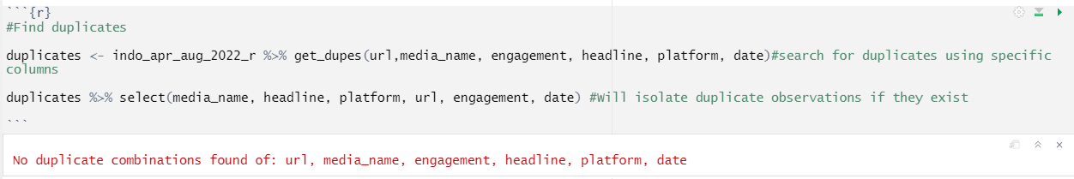
Code
Search for duplicate records meeting specific criteria
If duplicates are found, isolate and investigate further

Slide 21
cleaning data ex. 3
distinct()

Slide 22
Code
After confirming duplicates, remove by keeping only unique records
*Duplicate records can be subset into a separate data frame if necessary

Slide 23
validating data ex. 4
url.exists()

Slide 24
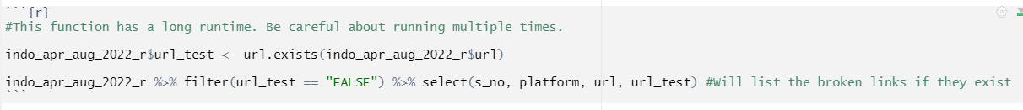
Code
Search for active url links
Isolate missing url links

Slide 25
Work in Progress
Add frequency checks to all variables to ensure cases have not been lost in cleansing process
Add validation measures for any other constraints that haven’t been addressed yet
Improve current list of companies, brands, and product models
Work on code to automatically upload URLs to Wayback Machine or some other platform where we can store post links.
Further identifying coding patterns we can use to improve coding of “subjective” data

Slide 26
Limitations
Subjective data with no clear decision pattern still needs to be manually recoded based on country teams subject matter expertise.

Slide 27
Summary
This approach can benefit TERM by creating more efficient analysis and reporting, while also allowing for more robust QA standards (tracking and reproducibility).

Slide 28
Next steps
Make appropriate changes to the code
Test code on the other most recent country datasets
Create SOP for TERM data management
Automate chart creation (Excel)
Build external dashboard (Tableau)

